Slide 1

VideoVigil (Violence Detection Web Extension)
Mubashir Ahmed FA20-BSE-063
Nabeel Ahmad FA20-BSE-170
Ghulam Abbass FA20-BSE-053
Supervisor: Mam Neeli Khan
Department of Computer Science
COMSATS University Islamabad, Abbottabad

Slide 2

Agenda
VideoVigil Introduction
Project Scope
Functional Requirements
Nonfunctional Requirements
Summary

Slide 3
Project Introduction
VideoVigil is a cutting-edge project aimed at addressing the critical issue of online violence and sensitive content portrayed in videos.
The project aims to develop a robust deep learning model capable of autonomously detecting instances of violence within videos.
By deploying as a web browser extension, VideoVigil offers easy accessibility and enhances online safety for users.
Ultimately, VideoVigil aims to contribute to creating a safer and more considerate online environment for users by prioritizing their well-being and safety.

Slide 4

Project Scope
Develop a robust deep learning model capable of detecting instances of violence and sensitive content within online videos.
Deploy the model as a web browser extension to provide users with real-time warnings about potentially distressing content.
Aim to contribute to a safer online environment by empowering users to make informed choices about their video consumption and promoting responsible internet usage.

Slide 5
Functional Requirements
Detect
Detect instances of violence and sensitive content within online videos.
Generate
Generate real-time warnings or alerts to inform users about potentially distressing content.
Ensure
Ensure compatibility with popular web browsers, including Chrome, Firefox, and Brave Browser
Implement
Implement YOLOv8 to detect instances of violence and sensitive content accurately..

Slide 6
Non-Functional Requirements
Performance: Achieve real-time video processing for timely detection.
Compatibility: Support various video formats and platforms.
Security: Protect user data and maintain confidentiality.
Robustness: Remain resilient to variations in video conditions.
Compliance: Adhere to privacy regulations and standards.

Slide 7
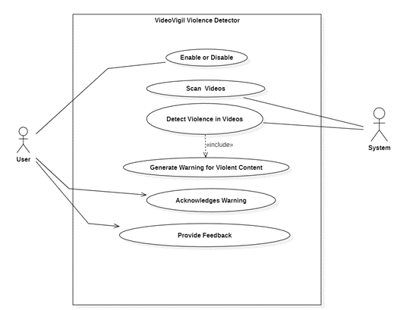
Use Cases Diagram

Slide 8
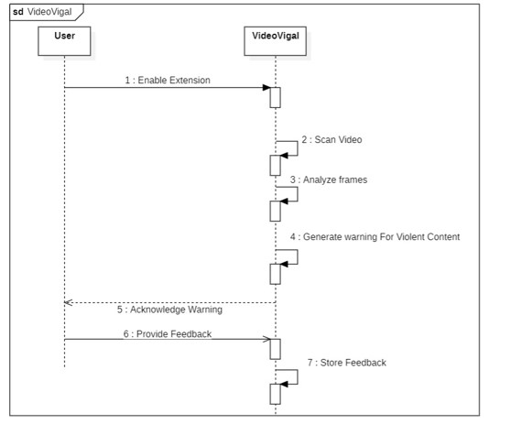
System Sequence

Slide 9
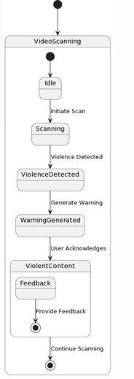
State Transition Diagram

Slide 10
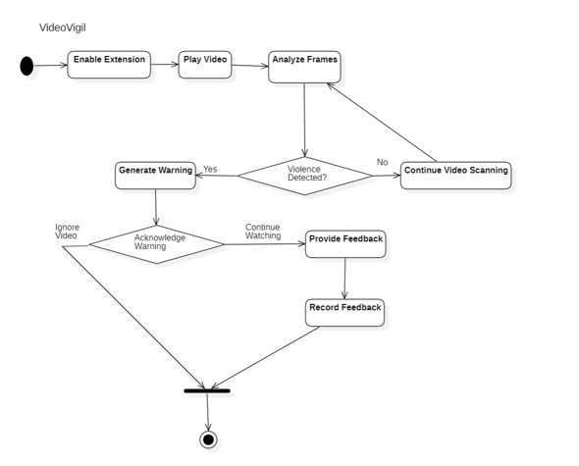
Activity Diagram

Slide 11
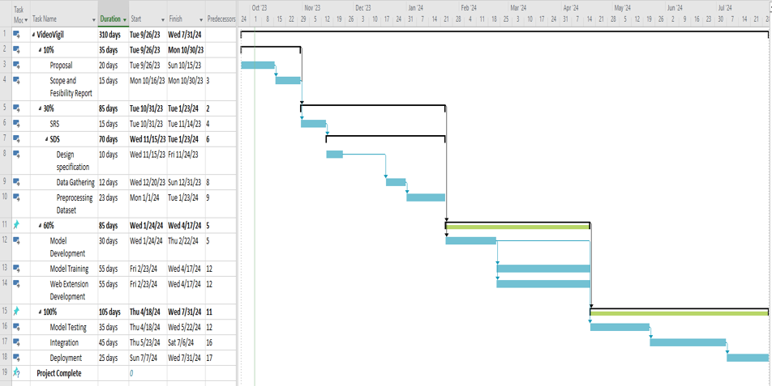
Gantt Chart

Slide 12

Summary of 30% Project Implementation
Violence detection implementation completed as per 60% task requirement.
Revised use case successfully addressed.
Utilized YOLOv8 algorithm for effective video analysis.
Developed and implemented a curated dataset comprising violence videos within a specified range.

